Slide 1

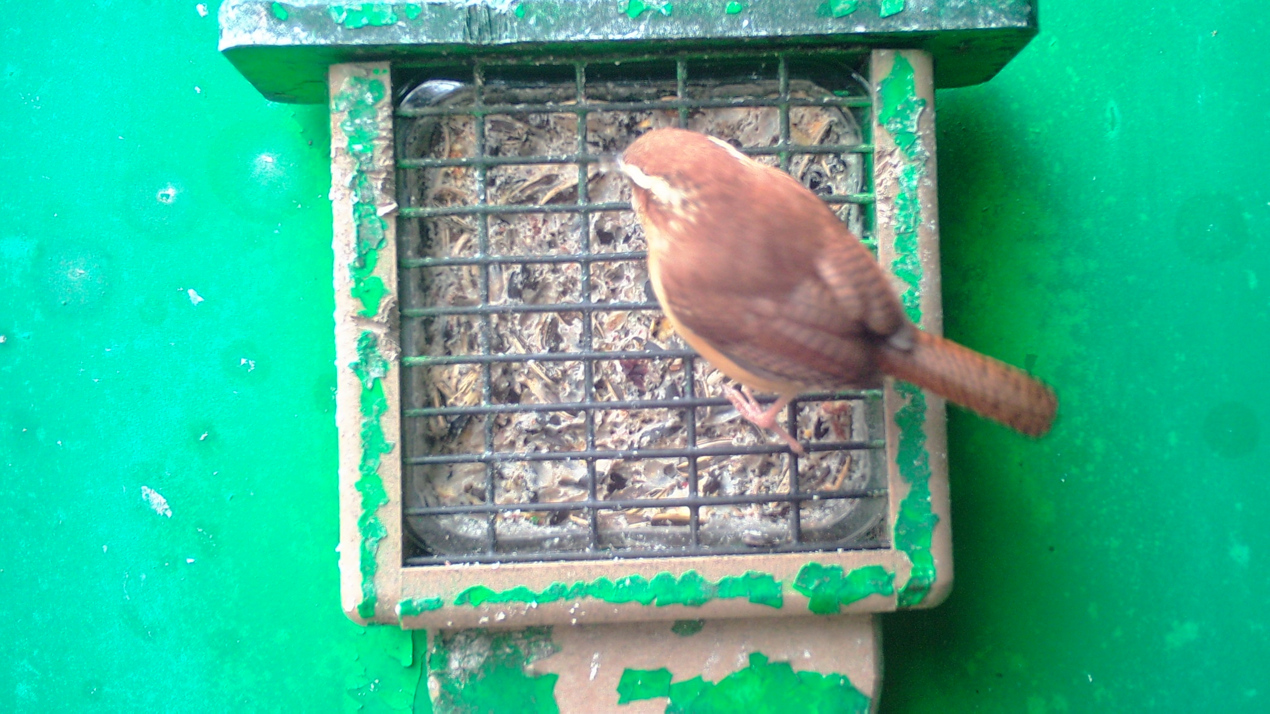
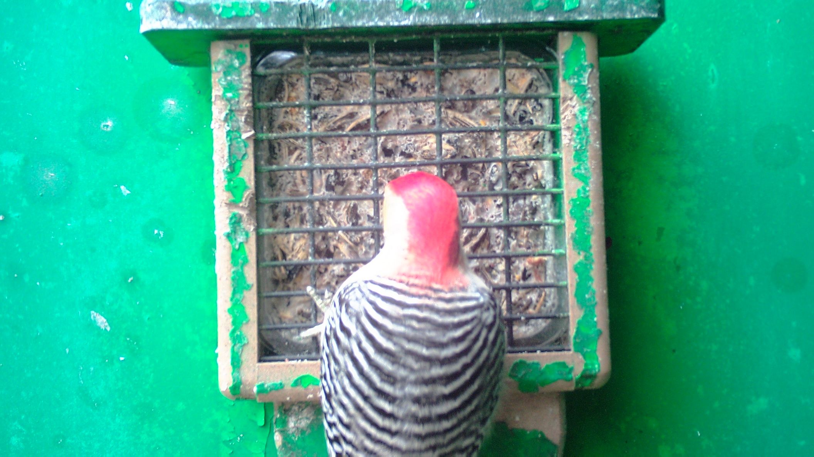
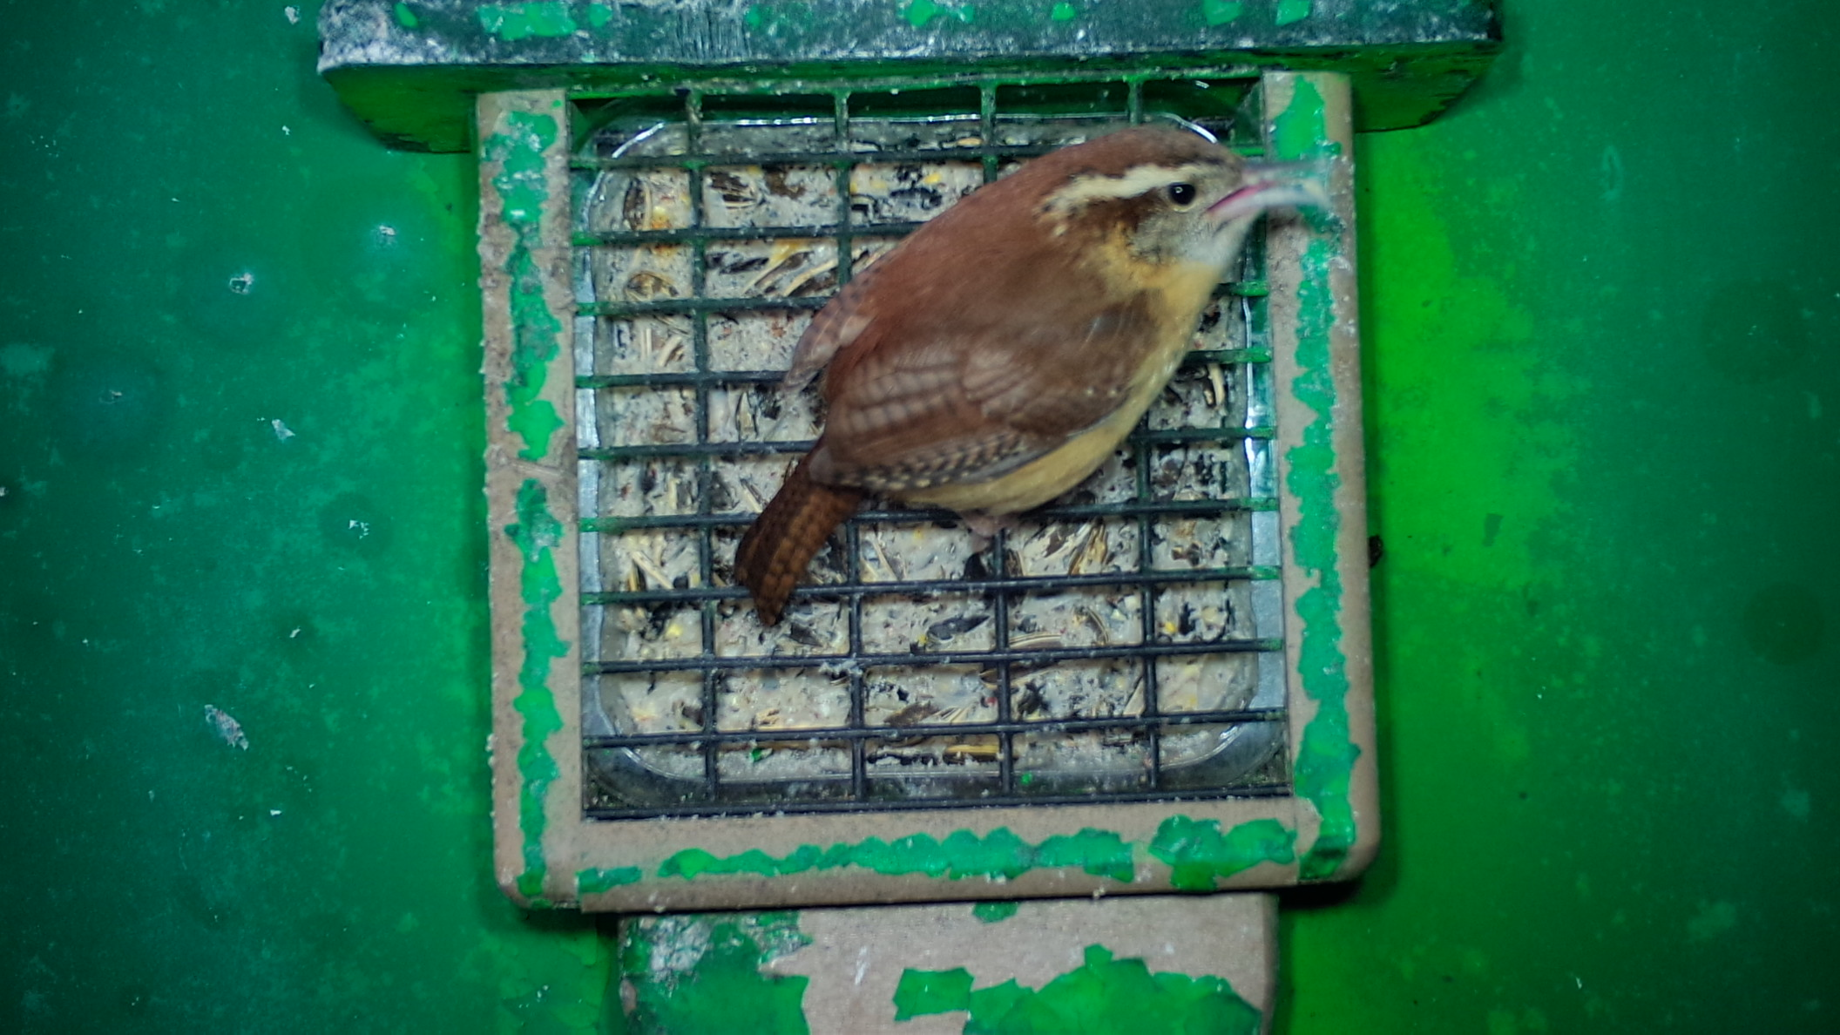
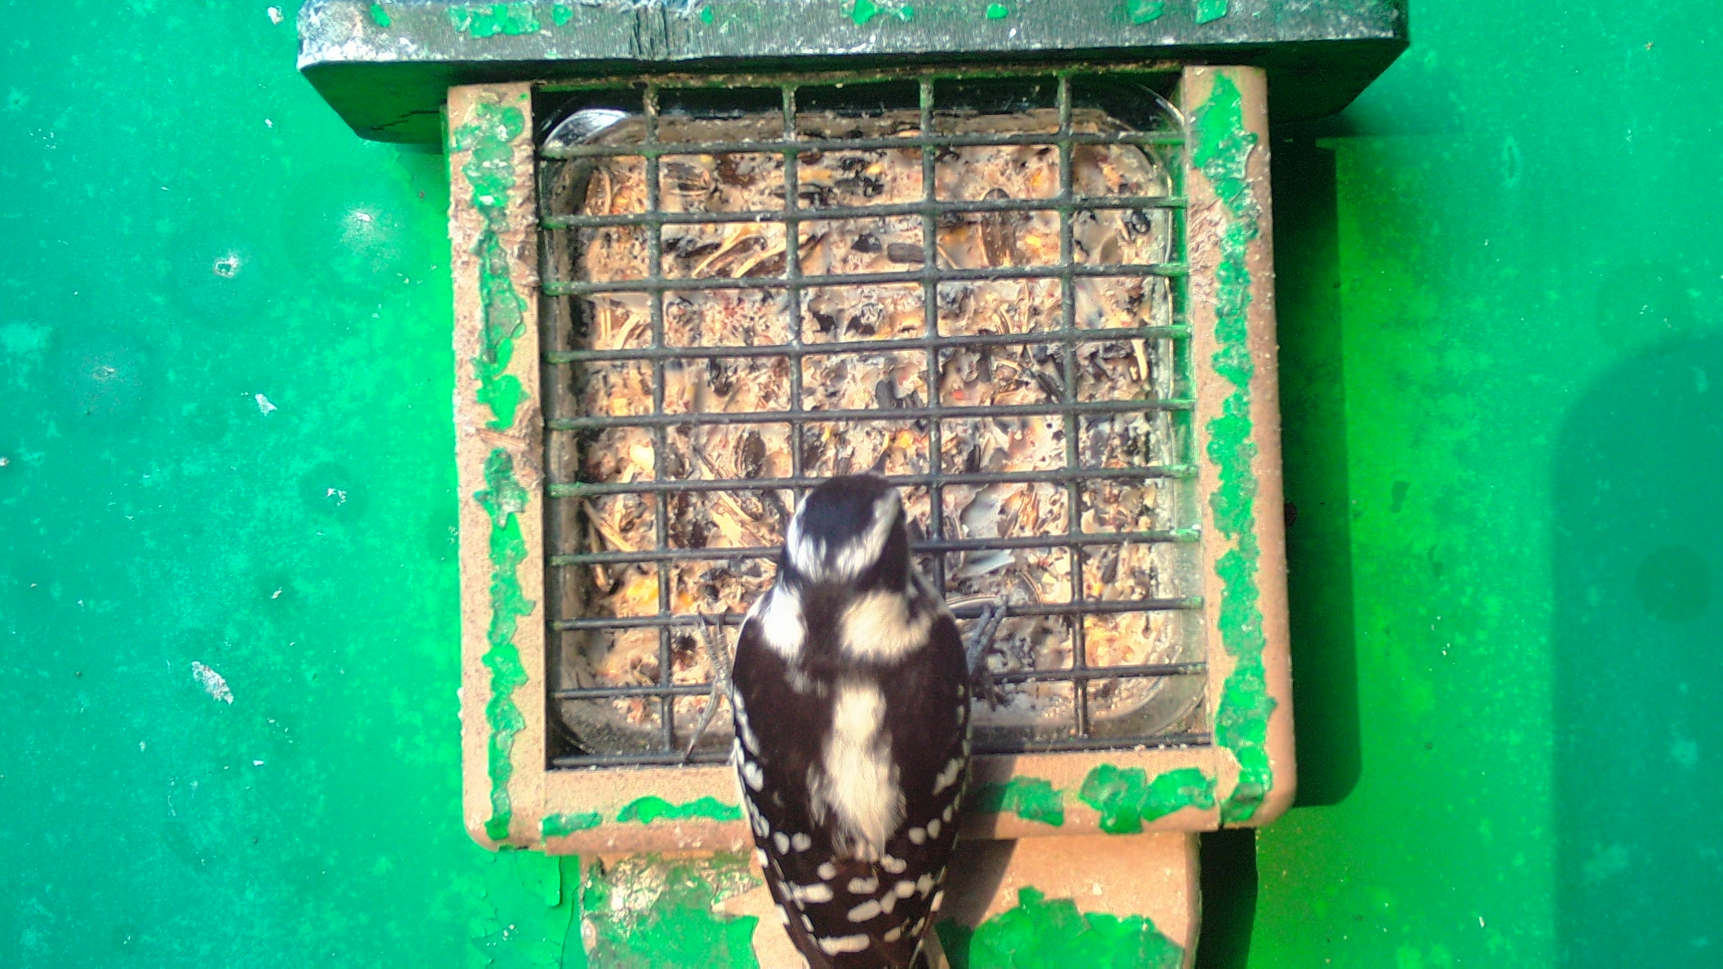
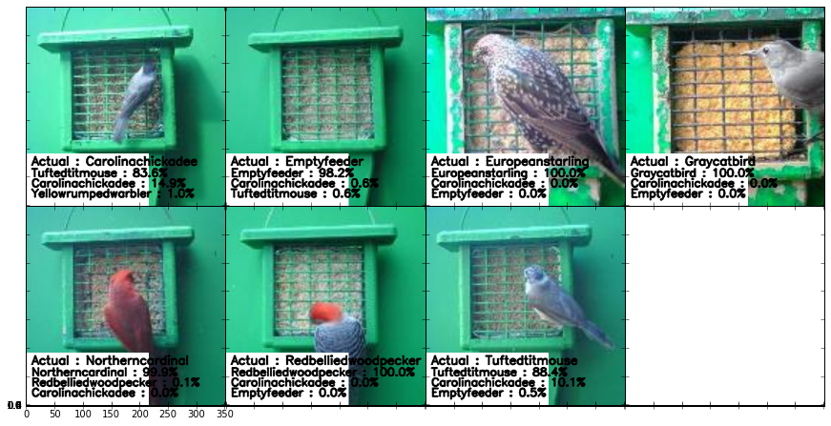
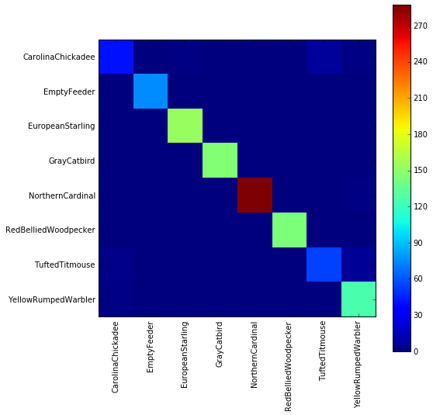
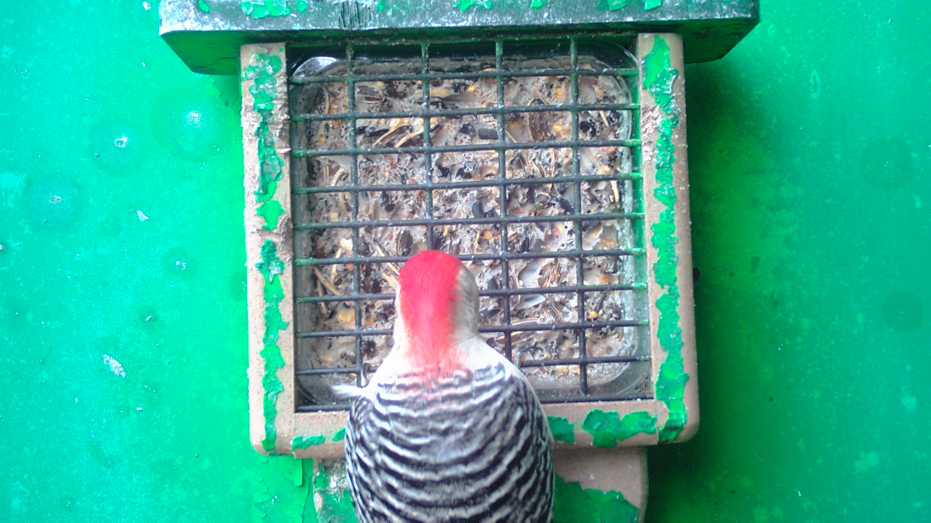
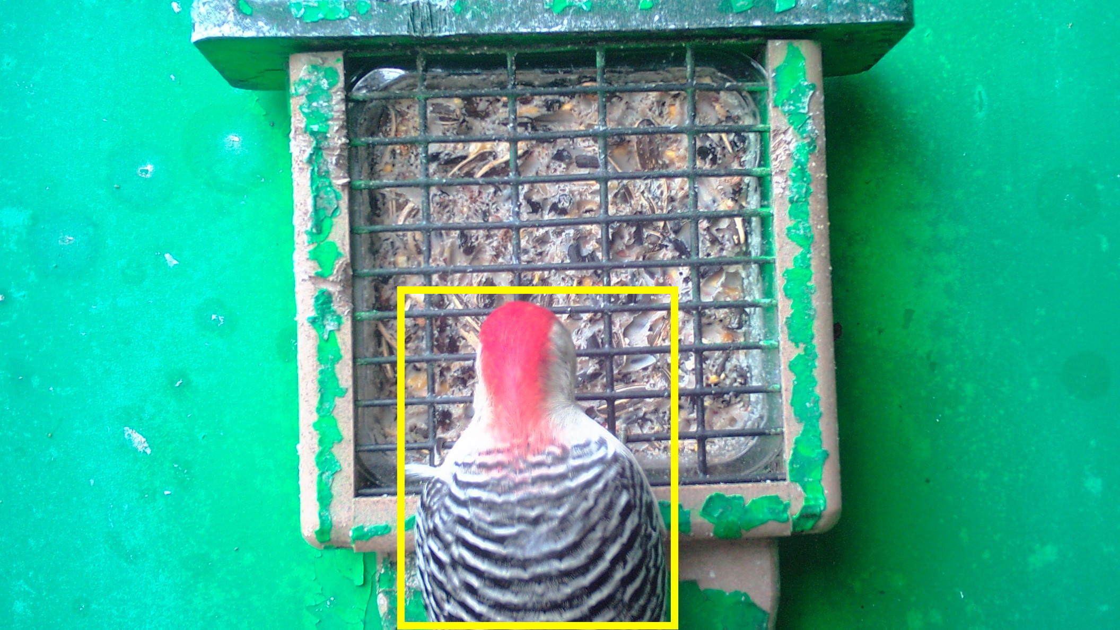
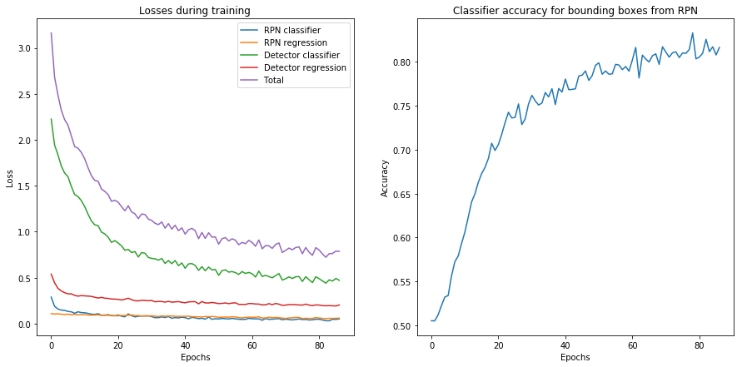
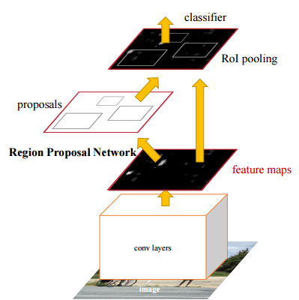
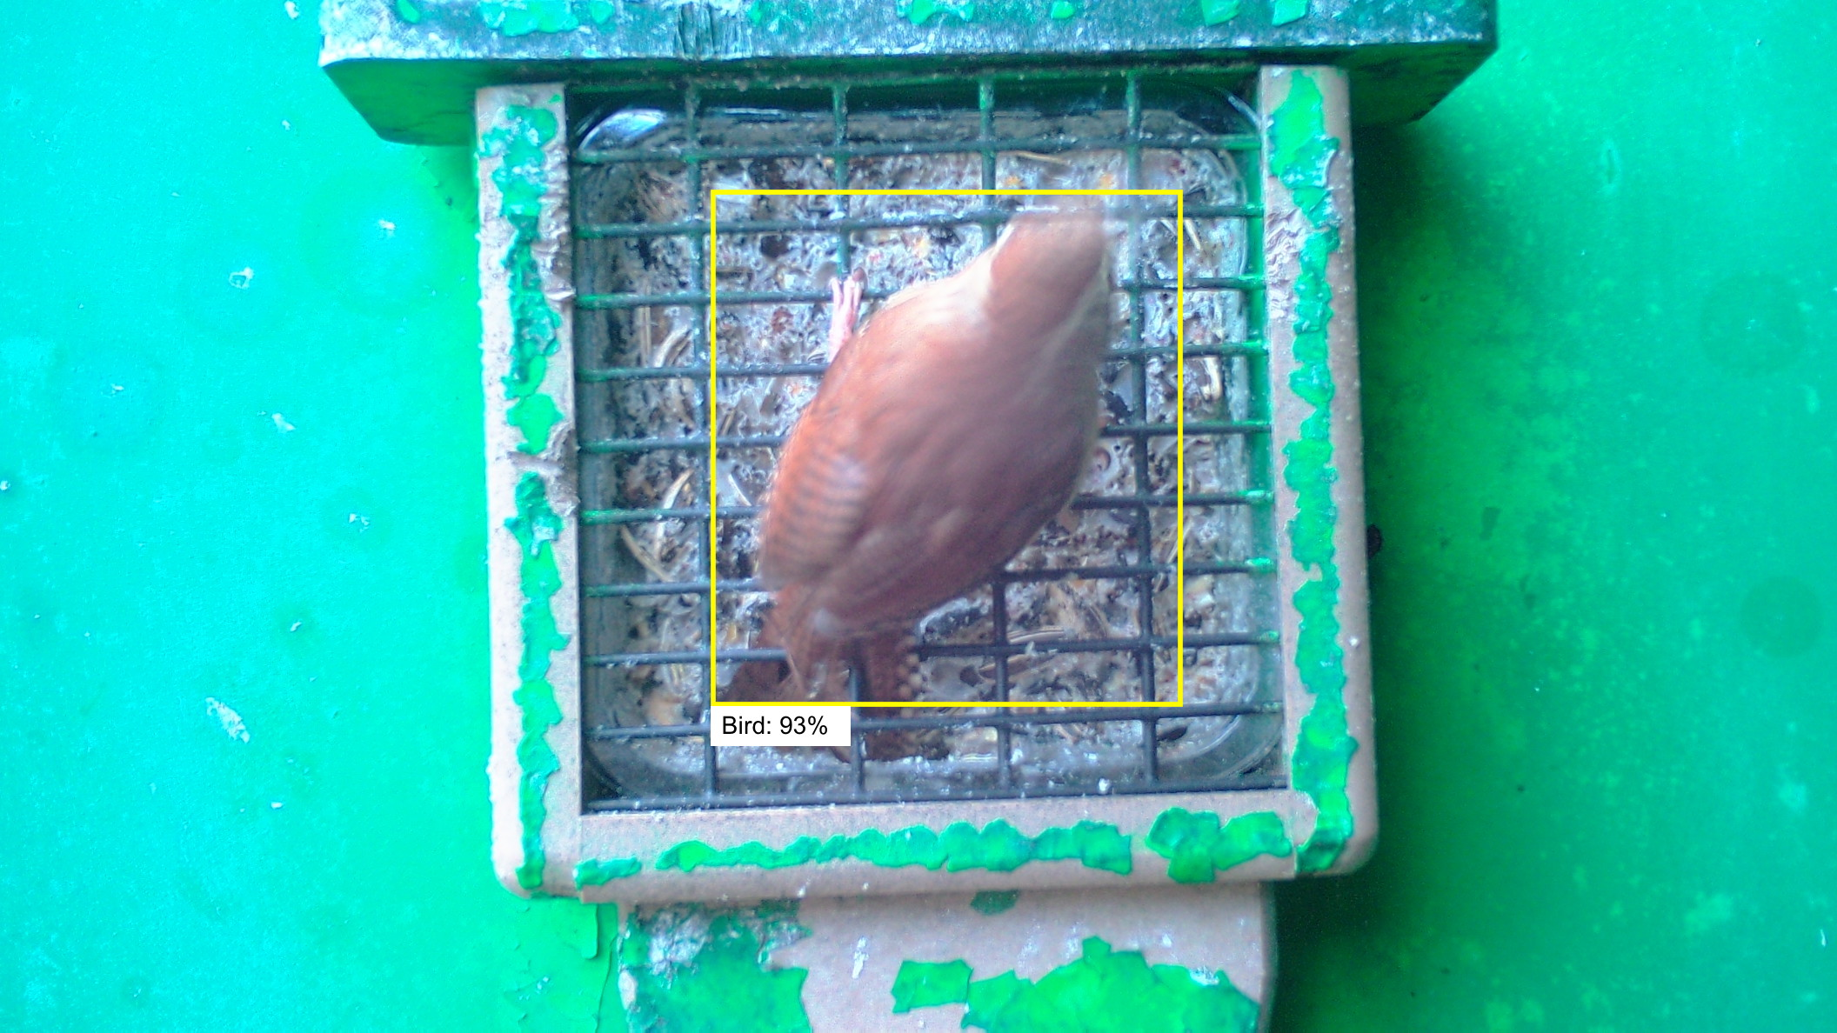
Image Classification and Object Detection by convolutional neural network
Wallace He with Dr. Lewis Barnett
School of Arts & Science, University of Richmond, VA 23173
Code and bibliography:
https://github.com/offthewallace/Summer-2017
https://github.com/lbarnett/birdid_bib
Introduction
Training
Future Improvement
Our goal:
Given an image of a bird, predict its species using deep learning techniques.
If we can accurately classify bird images, Can we also get the position of the bird.
Methods/Tools for research:
Convolutional neural network for image classification
Faster R-CNN(Regional convolutional neural network) for object detection
Keras: an open source neural network library written in Python
I used 8 classes of birds with more than 3000 pictures for training CNN and 2 classes of birds/no_birds with more than 1000 picture for training FRCNN.
Images are resized to be 140 * 140 pixels before training. This shortens training time greatly without sacrificing image quality too much.
Images with large shadow areas can confuse the network and lower the training accuracy. Different shadow removal techniques have applied but none has shown promising result.
For object detection, all the data has to be assigned a bounding box region. For my code, I saved the X,Y position of the up-left and down-right points of the bounding box in a txt file with the image name as training data input.
Our model was trained with 60% of the entire data set. 50% of remaining images (20% of the entire image set) was used to validate the training accuracy, and the rest images (20%) was used to test the final trained network. Stratified random splits was used to create the training, validation and testing sets. The goal is to get a highest (average) accuracy score for the test set with our trained network.
Amazon EC2 instances utilize GPU for training. Due to the advantage of parallel processing GPUs have on CPUs, the training process is about 20 times faster on the Amazon EC2. However, the training for FRCNN still takes for around 8 hours.
The training data can be processed inside of Keras’ ImageDataGenerator function by applying ZCA whitening, randomly rotate and randomly shift. For small dataset, it can help to increase the accuracy .
Put more labeled images with different classes for training FRCNN model.
Use better visualization library for displaying the output result.
Add differential privacy algorithm for data protection.
Apply more advanced algorithm for object detection.
Detail of Methods
Image Augmentation
Result
As one of the most active fields in computer science study nowadays, deep learning provides cutting edge solution for image classification, and Object Detection.
A convolutional neural network (CNN) has four main operations: Convolution, Non Linearity (ReLU), Pooling or Sub Sampling, and Classification (Fully Connected Layer).
・Convolution Step: extract features from the input image. Convolution preserves the spatial relationship between pixels by learning image features using small squares of input data.
・Non Linearity (ReLU): element wise operation (applied per pixel) to introduce non-linearity in CNN.
・Pooling Step: spatial Pooling (also called subsampling or down-sampling) reduces the dimensionality of each feature map but retains the most important information.
・Classification Step: use features output from the convolutional and pooling layers for classifying the input image into various classes based on the training dataset.
For image classification, the total accuracy is over 97 percent with 8 classes. However, model makes confuse between Tufted Titmouse and Carolina Checkadee by less training pictures in those classes.
Our Training Process
Two categories yield an accuracy of 80 percent for predicting the bounding box.
Convolutional neural network
A Faster RCNN gets feature map from the last convolutional layer like regular CNN. Then the Region Proposal Network (RPN) with a convnet proposes Region of Interest (RoI) and projects them on the feature map. Each proposed region is passed into a RoI pooling layer to generate fixed-length output. The classifiers would pass proposal feature maps into full connected and softmax layer for classify.
Similarly, fewer categories yield a more consistent result. However, the difference is less noticeable as well. At 14 categories, the test accuracy varies from 85.5% to 88.8%, whereas at 2 categories, test accuracy varies from 98.3% to 100%.
Faster R-CNN

